Slide 1
Manson Athletics Program Review
2021

Slide 2
Recent Highlights
Volleyball Undefeated
Cross Country League Boys And Girls League Champs
High Turnouts For Most Sports
Successfully Launched Wrestling and Tennis
Stayed Staff And Positive During A Crazy Season
Recently Increased The Pay For Our Dedicated Coaches

Slide 3
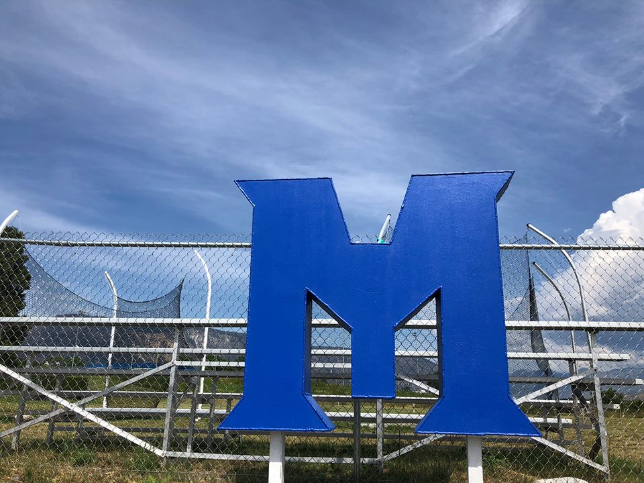
Sports Offered

Slide 4
Sports Offered Fall 2021
High School
Middle School
Volleyball
Coach Hayli-Thompson
Football
Coach Joey Johanson
Girls Soccer
Coach Gilberto Romero
Cross Country
Coach Annette Quarre
Cheer
Rosie Rodriguez
Volleyball
Coach Sarah Wiggum
8-Man Football
Coach Steve Nygreen
Cross Country
Coach Annette Quarre

Slide 5
Sports Offered Winter 2021-2022
High School
Middle School
Boys Basketball
Coach Eric Sivertson
Girls Basketball
Coach Steve Nygreen
Wrestling
Sam Lovelace
Boys Basketball
Coach Jesse Villalobos
Girls Basketball
Coach TBD

Slide 6
Sports Offered Spring 2022
High School
Middle School
Track
Coach Lauren Johnson
Softball
Coach Hayli Thompson
Baseball
Coach Bill Thompson
Boys Soccer
Coach Junior Valdovinos
Tennis
Coach Joey Johanson
Track
Coach Lauren Johnson

Slide 7
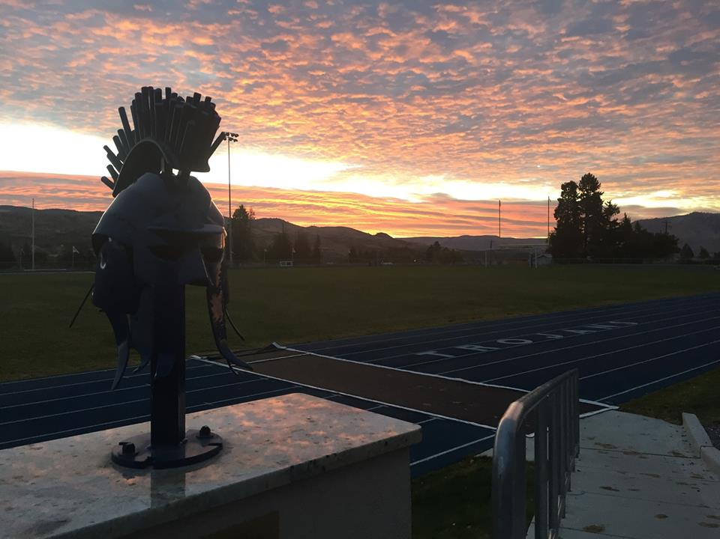
Facilities

Slide 8
Facilities Improvements
Gym Improvement
Baseball and Softball Fence Additions
Locker Room Remodel

Slide 9
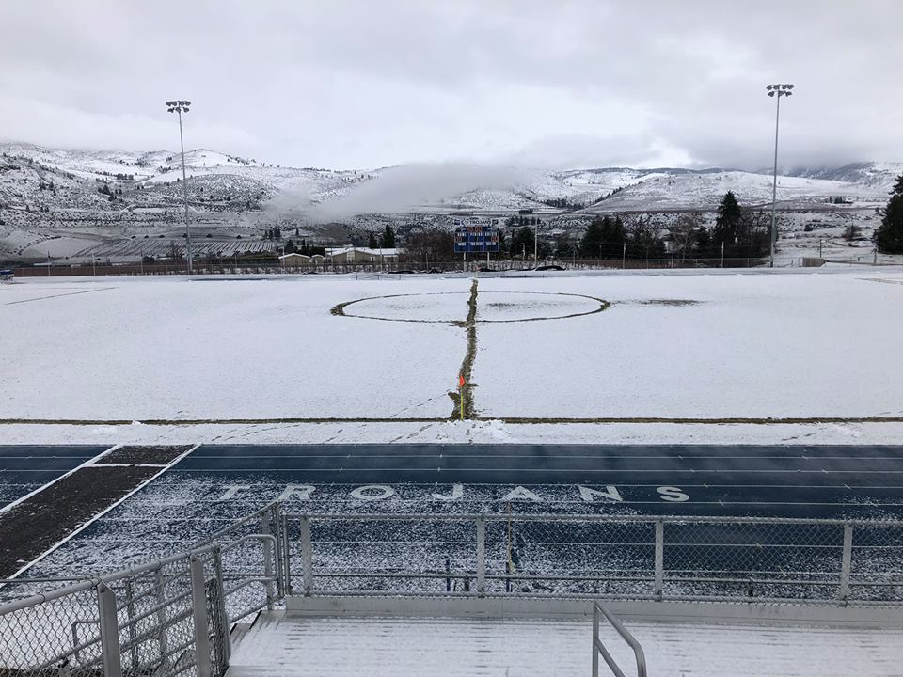
Covid Protocols

Slide 10
Covid Protocols
Fans
Outdoor without mask
Indoor with mask- It does not matter if you are vaccinated
Masks on Players
Currently indoor players not competing need to wear masks
Tests
High risk indoor sports must test.
Wrestling, Basketball

Slide 11
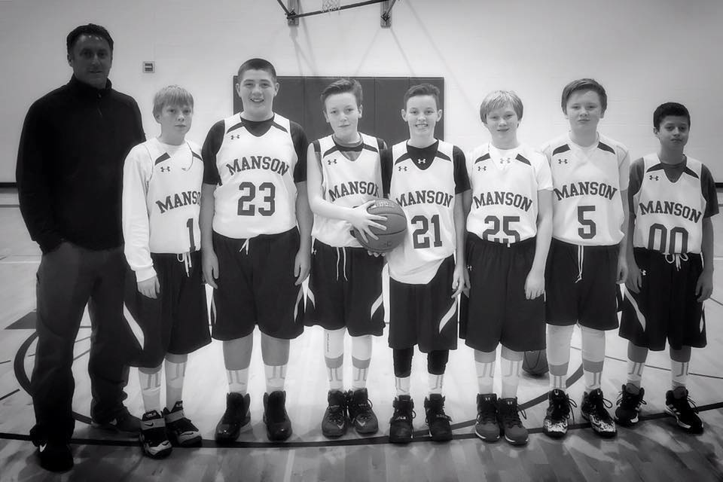
Back To Normal

Slide 12
Some Things That Are Back
Playoffs
State Tournaments
All League
Some Competitive Clubs
Robotics
Knowledge Bowl
FBLA
NEW COMPETITIVE CLUB-ESports

